Slide 1
Unit 1 My Day
五年级

Slide 2

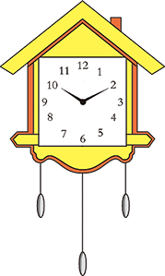
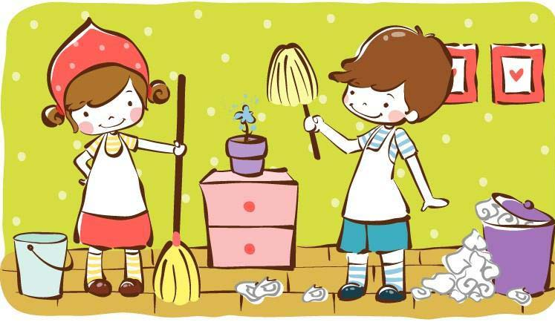
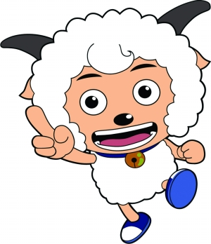
Let's spell
clock
cl
class
clean
clever

Slide 3

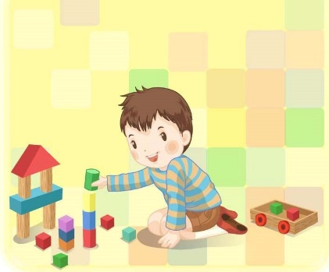
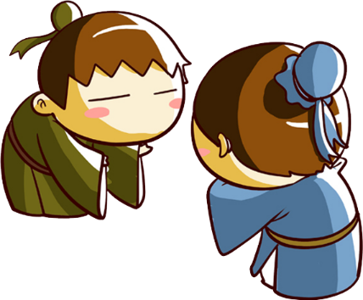

Let's spell
eggplant
play
pl
plate
please

Slide 4
Read the sentences
We have five players in our class.
They often play football in the playground.
Let them clean the classroom now.
My uncle has some new clothes.
Can I have a clean plate, please?

Slide 5
Homework
Listen to P6.
Find more words with “cl”,”pl”.

Slide 6
house
mouth
round
count
thousand
around
loud
about
blouse
our
out
outside

Slide 7
D(Different) or S(Same)
( ) cow mouse
S
( ) yellow house
D
D
S
( ) snow mouth
( ) how count
( ) brown out
S
( ) window about
D

